Slide 1

EMBEDDING DATA AND DIGITALIZATION
Global Economic Trends (GET)
Master in Management (MIM)
22nd September 2022

Slide 2



Slide 4
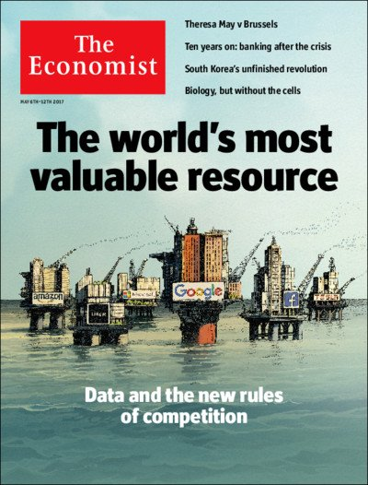

Slide 5
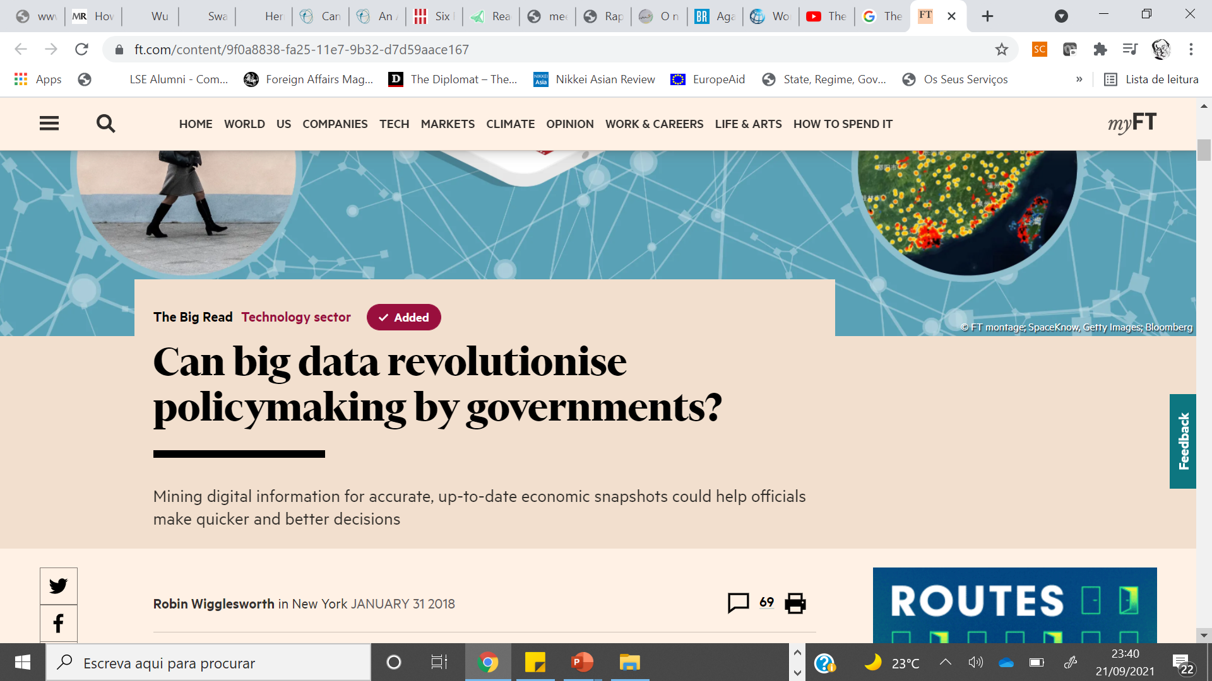

Slide 6

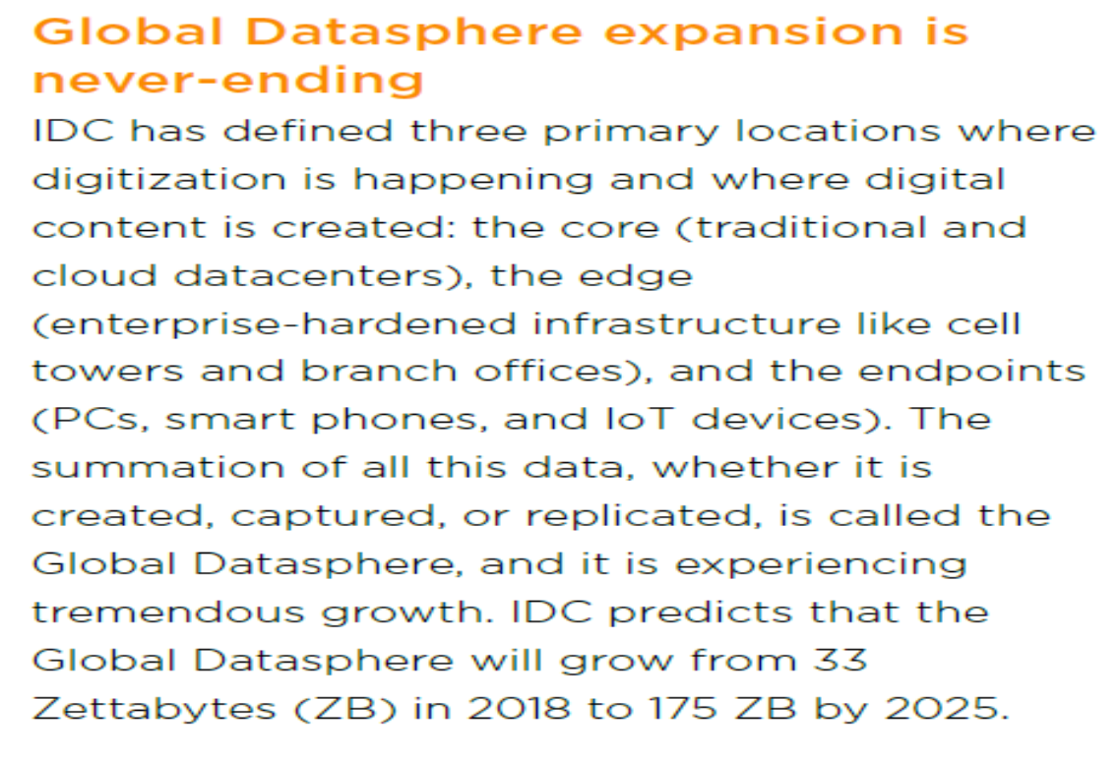
GLOBAL DATASPHERE (IDC, 2018)

Slide 10
PERSONAL DATA AS A NEW ASSET CLASS
(WEF, 2011)
-Personal data = as data created by and about people
-» volunteered data – created and willfully shared by individuals
-» observed data – captured by keeping the records of individual´s movements/actions
-» inferred data – data about individuals based on analysis of volunteered and observed data (metadata)

Slide 12


Slide 14



Slide 17
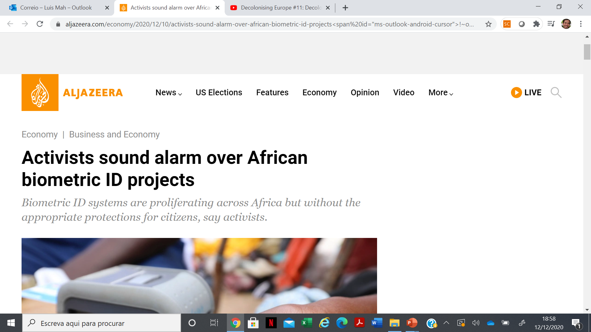

Slide 18
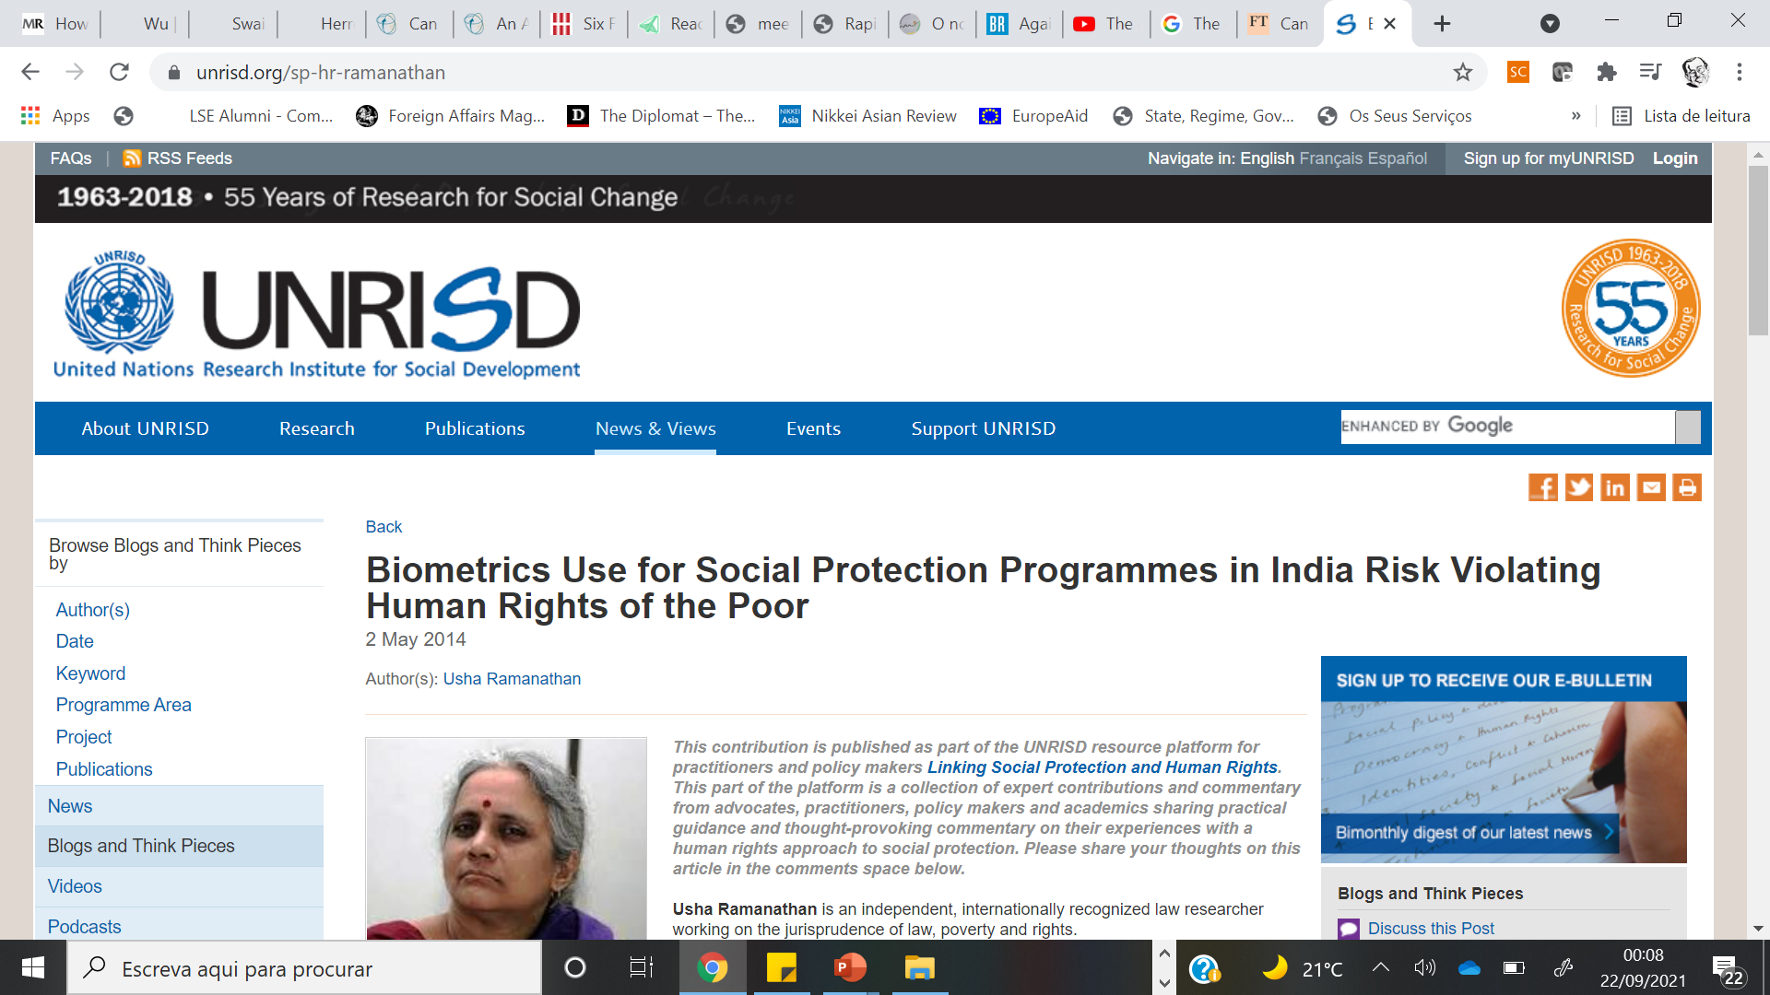

Slide 19
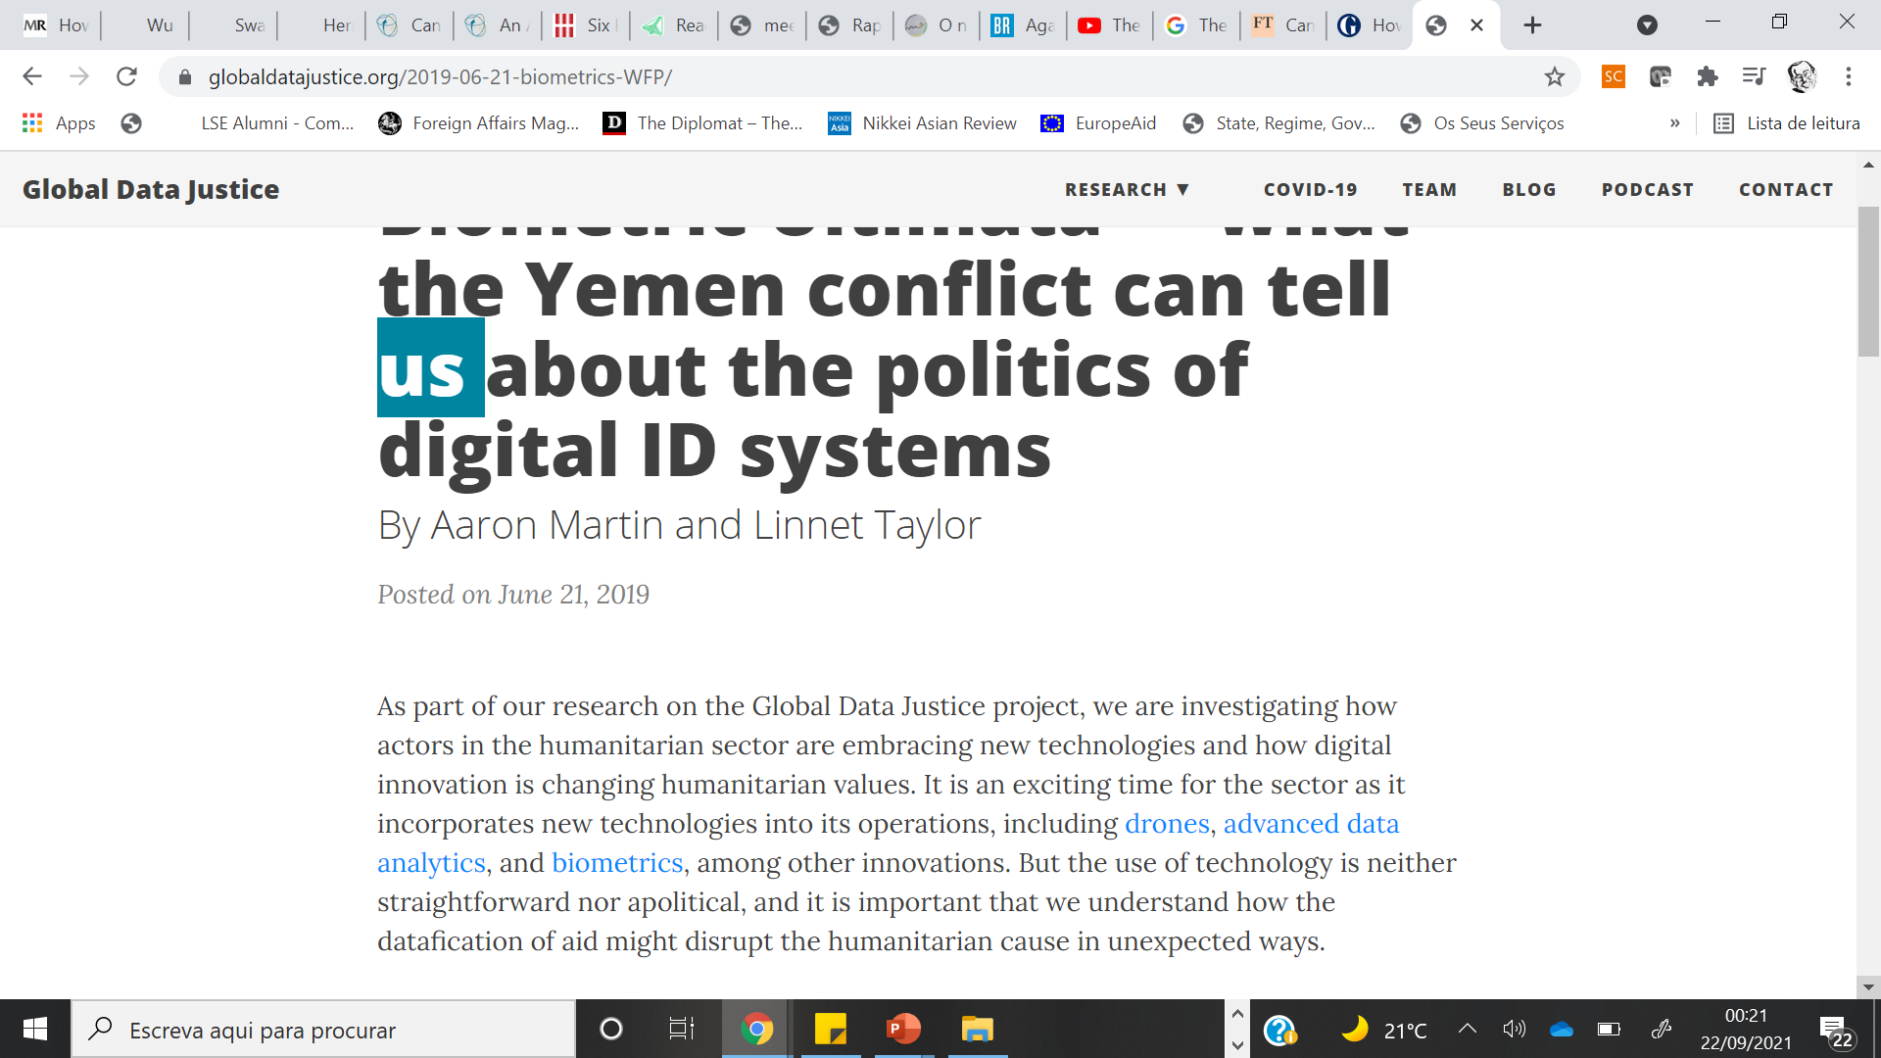

Slide 20
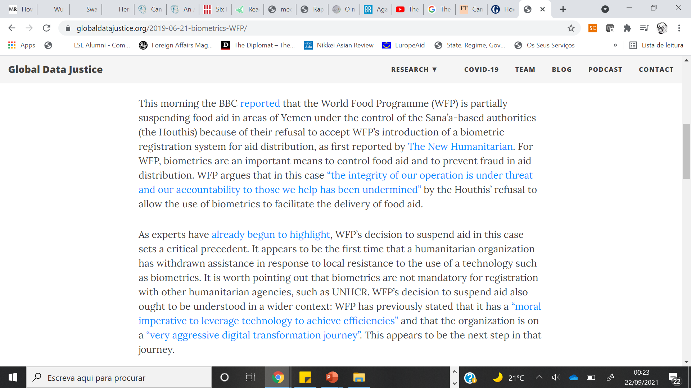

Slide 21
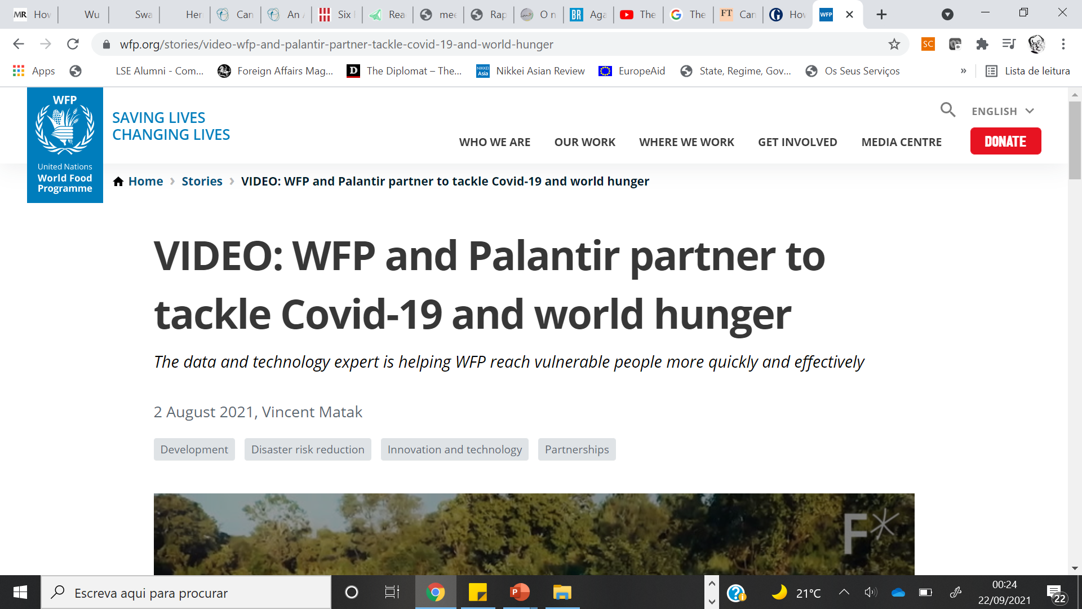

Slide 22
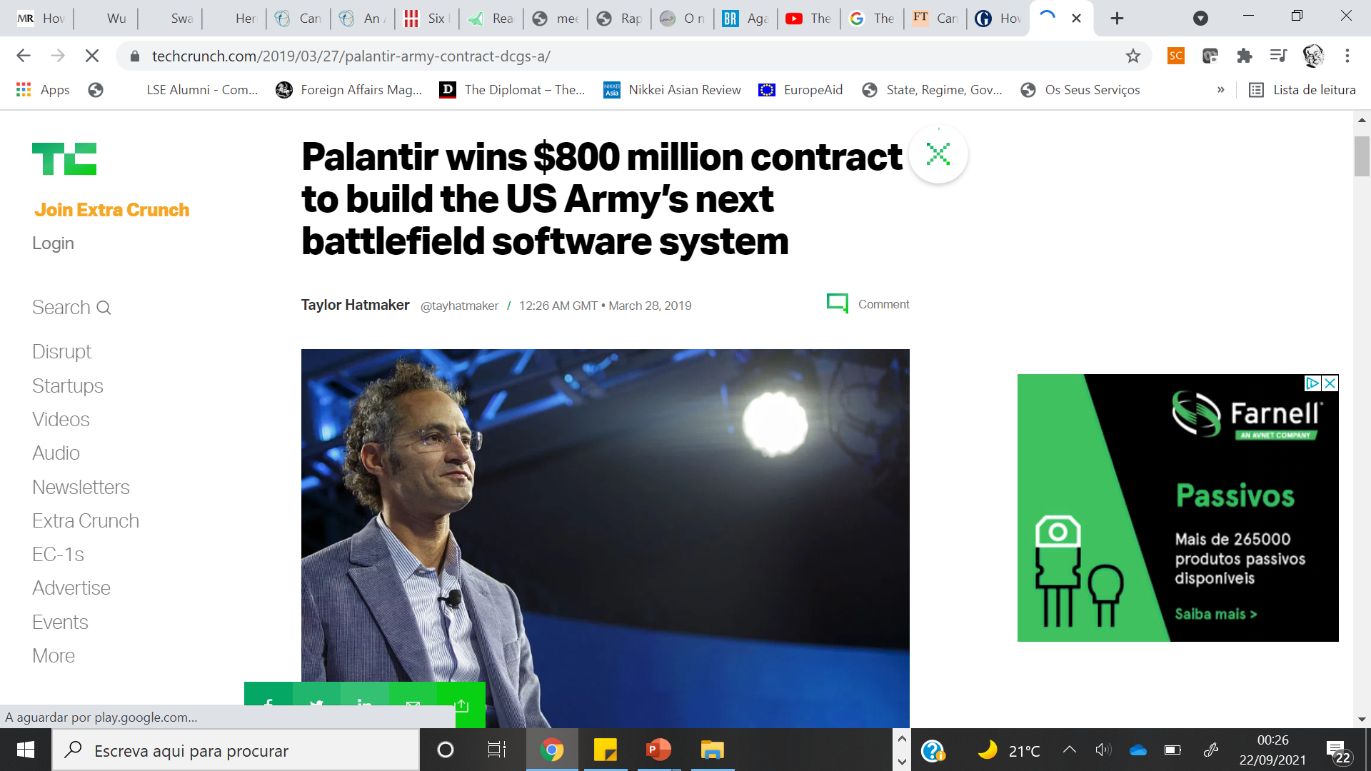

Slide 23
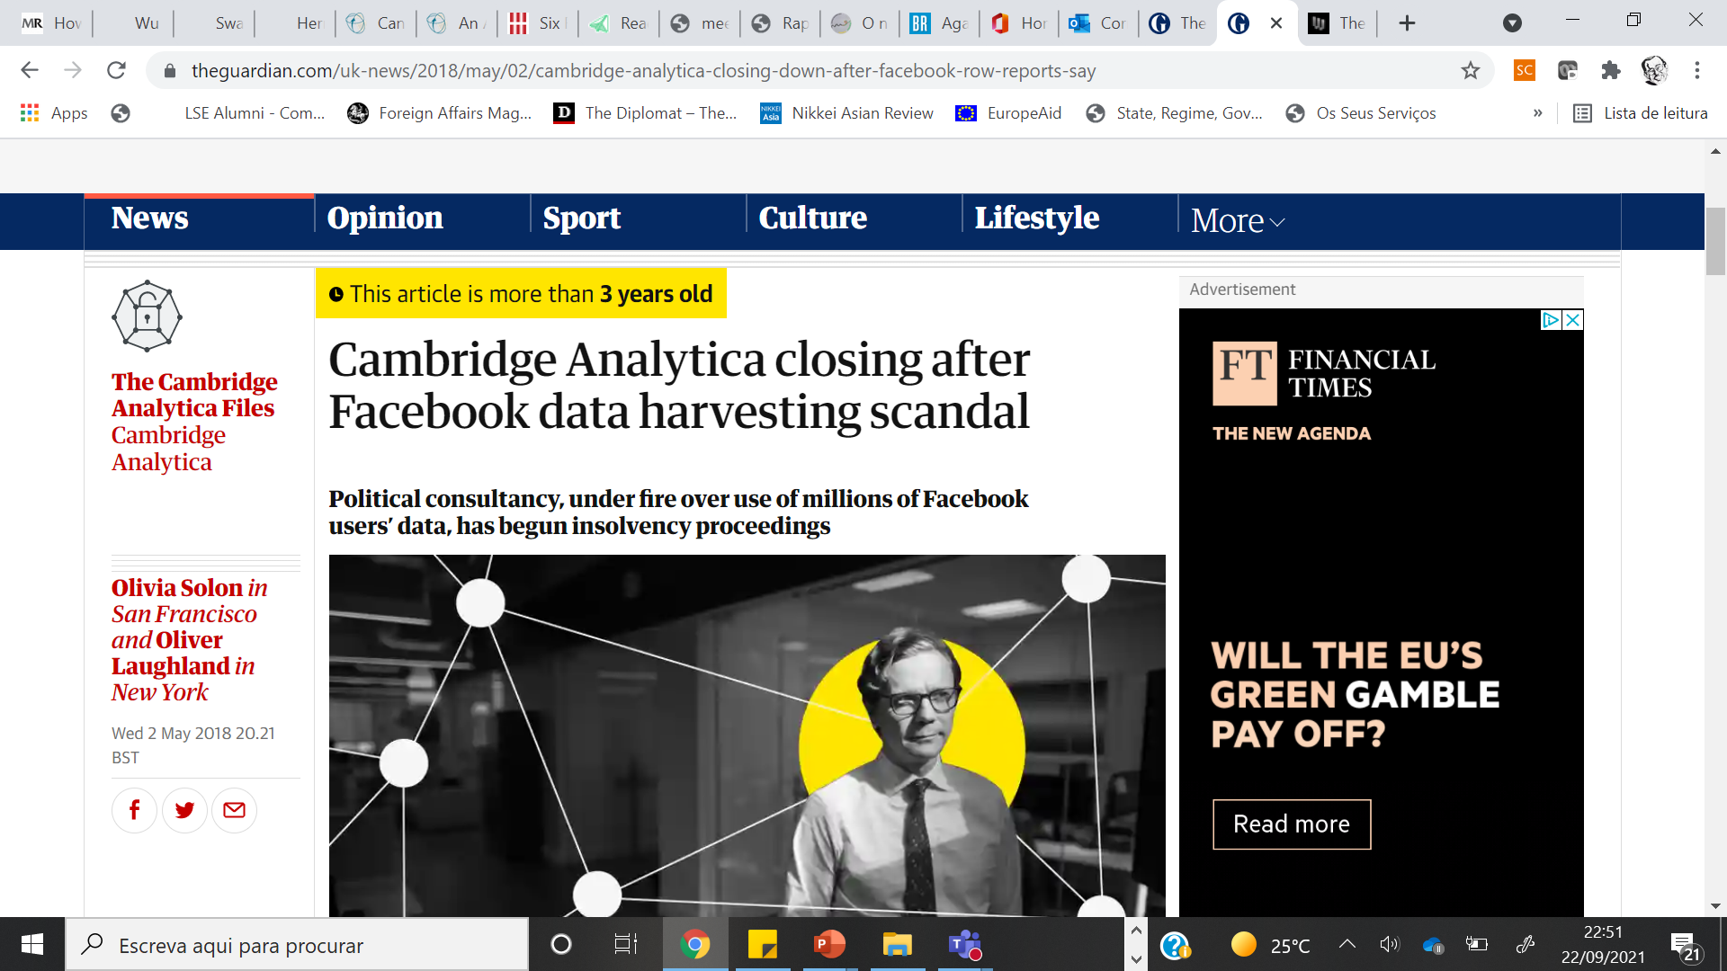

Slide 24
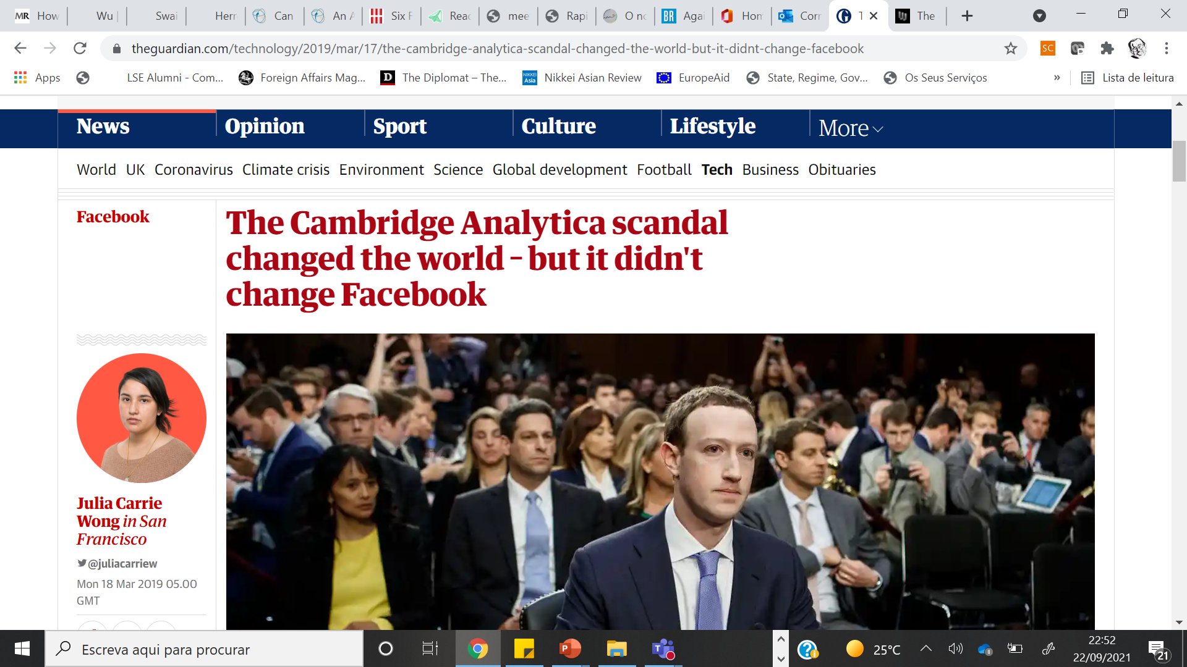

Slide 25
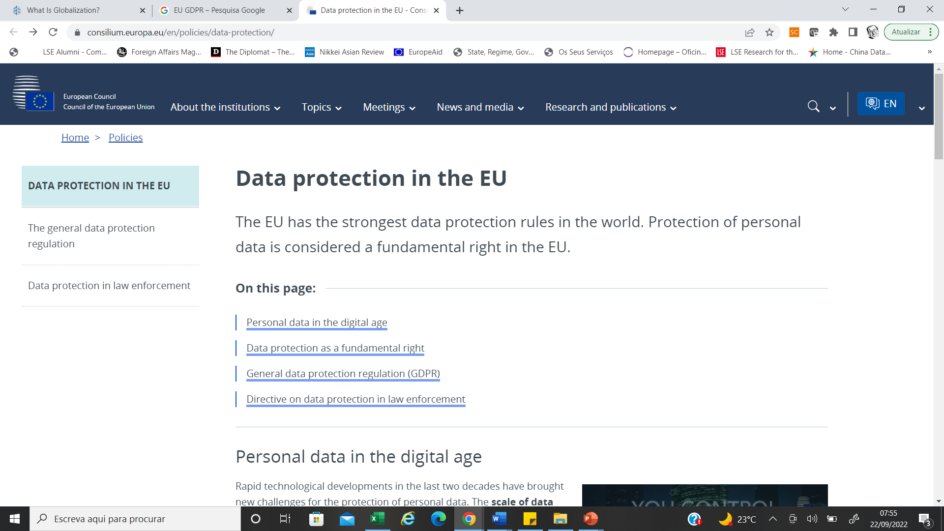

Slide 26
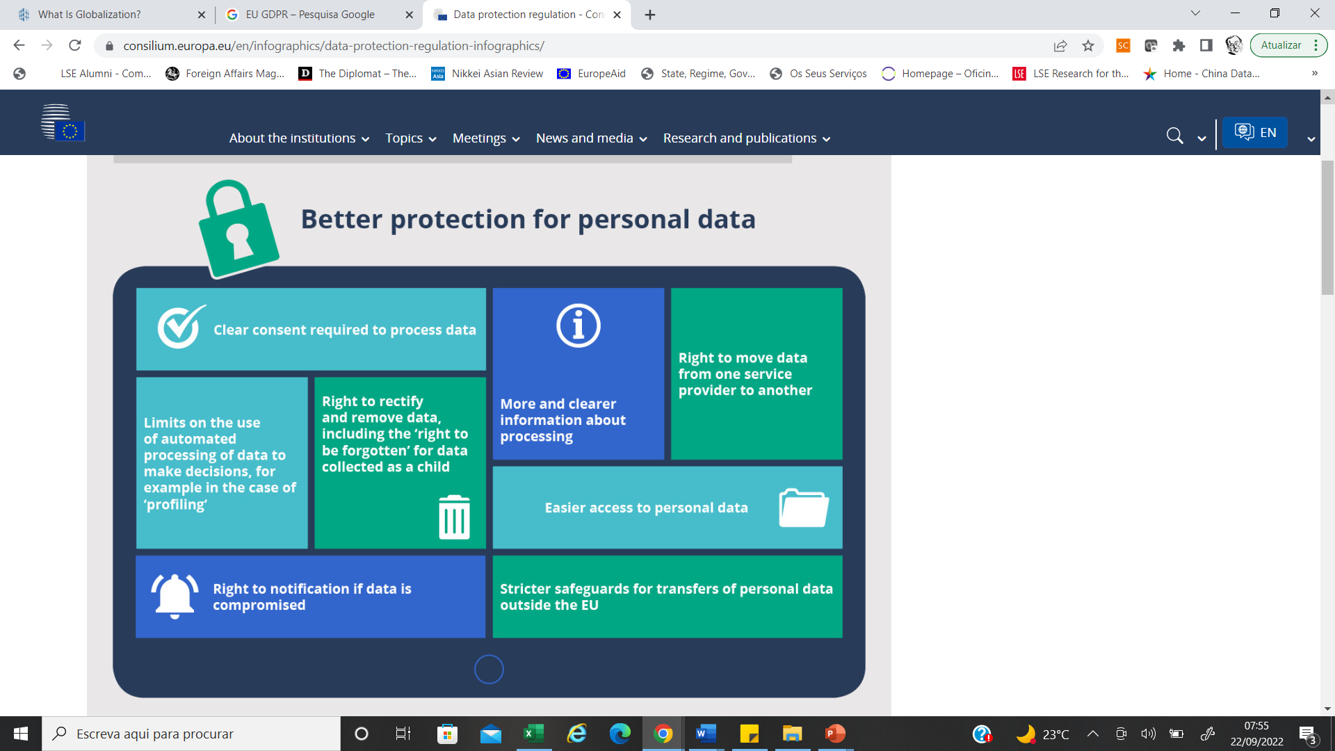

Slide 27
We need to talk about algorithms.

Slide 28
What are they?
-»Sets of instructions which compute data to solve a problem and achieve a goal.
-»Your dinner, a precision strike by a UAV or a stock market position.

Slide 29
Are Algorithms neutral?
Who owns them? Who owns the data that trains them?

Slide 30
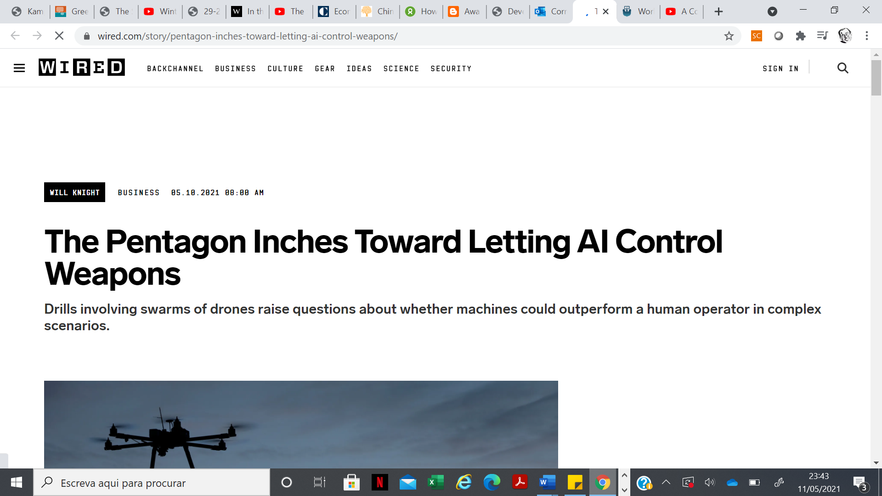

Slide 31
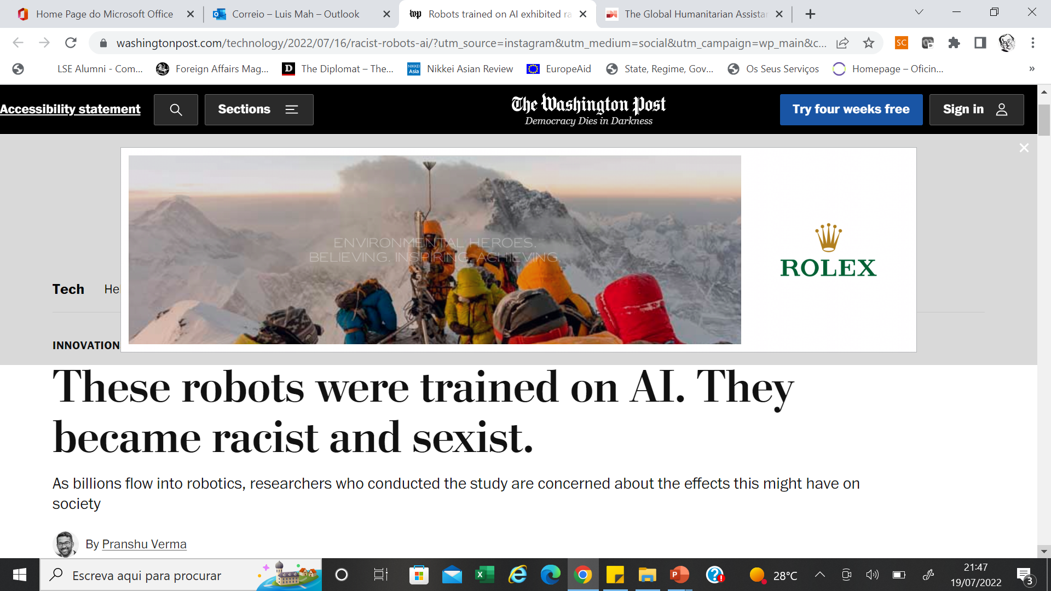

Slide 32
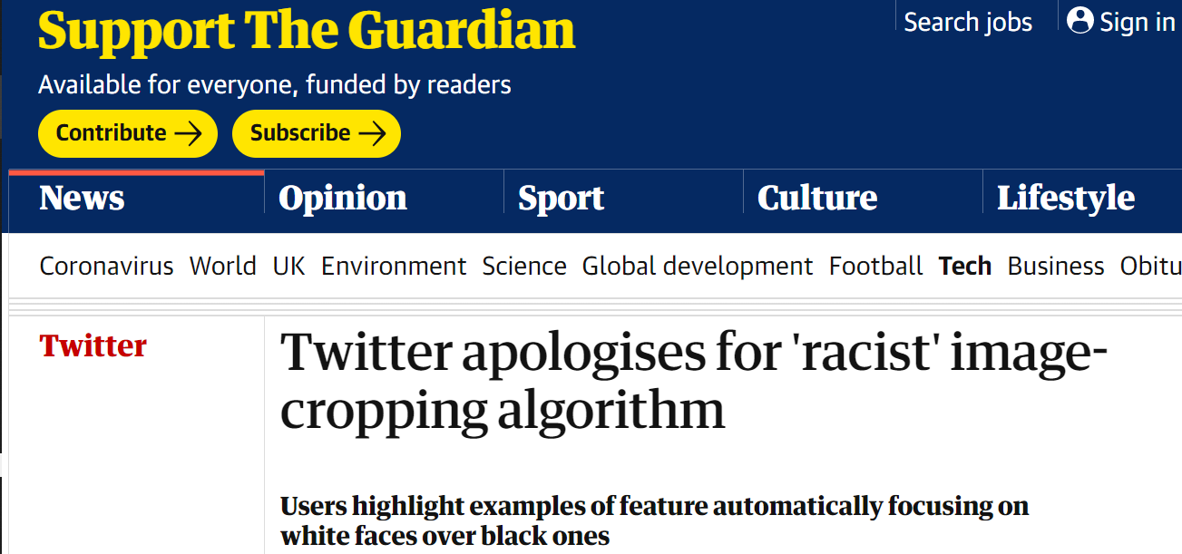
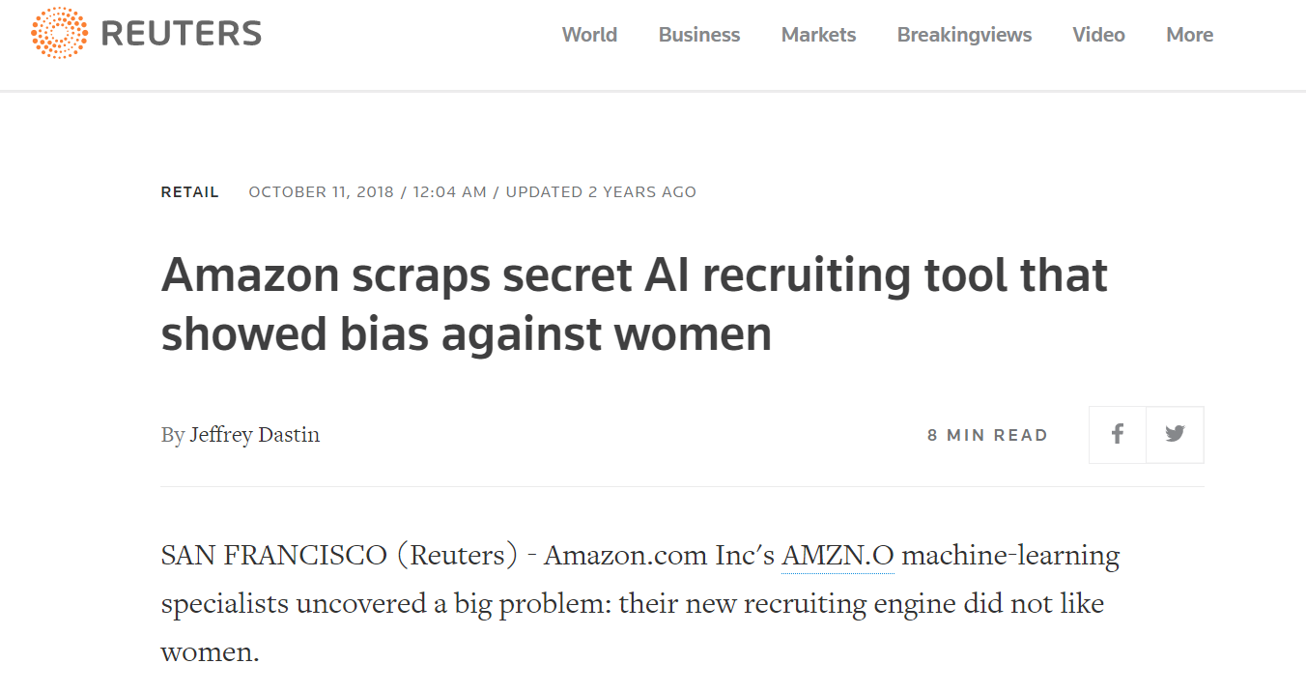
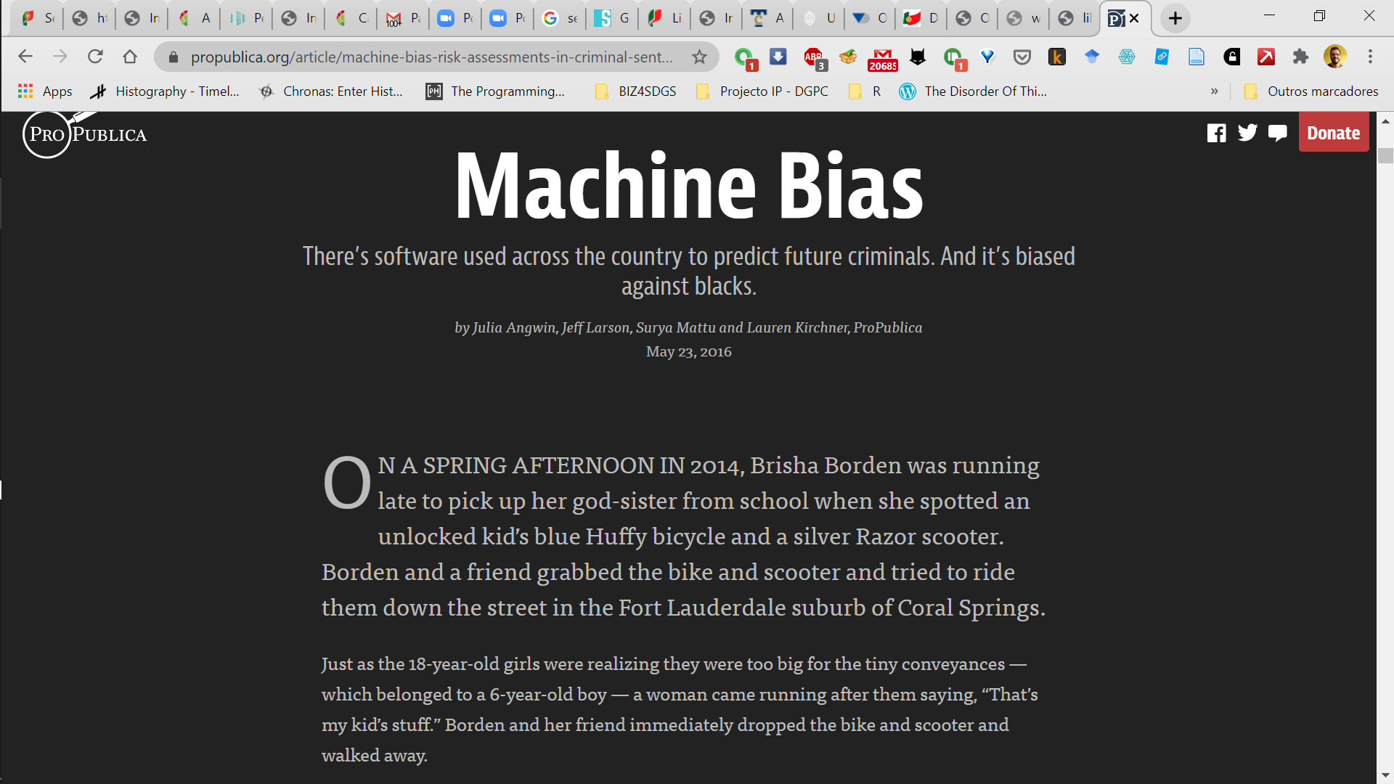
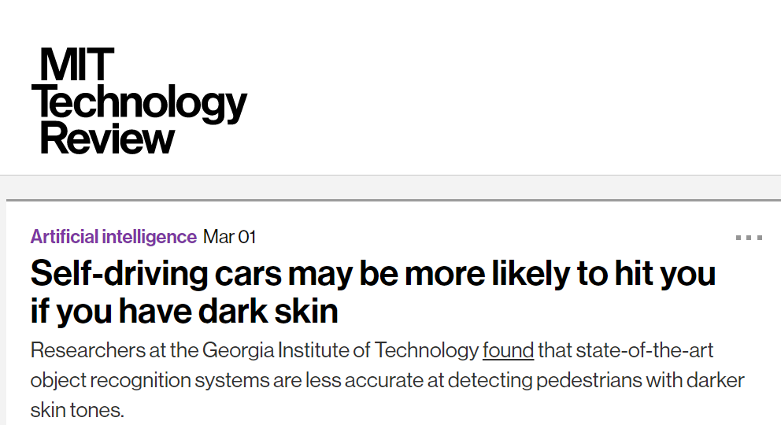

Slide 33
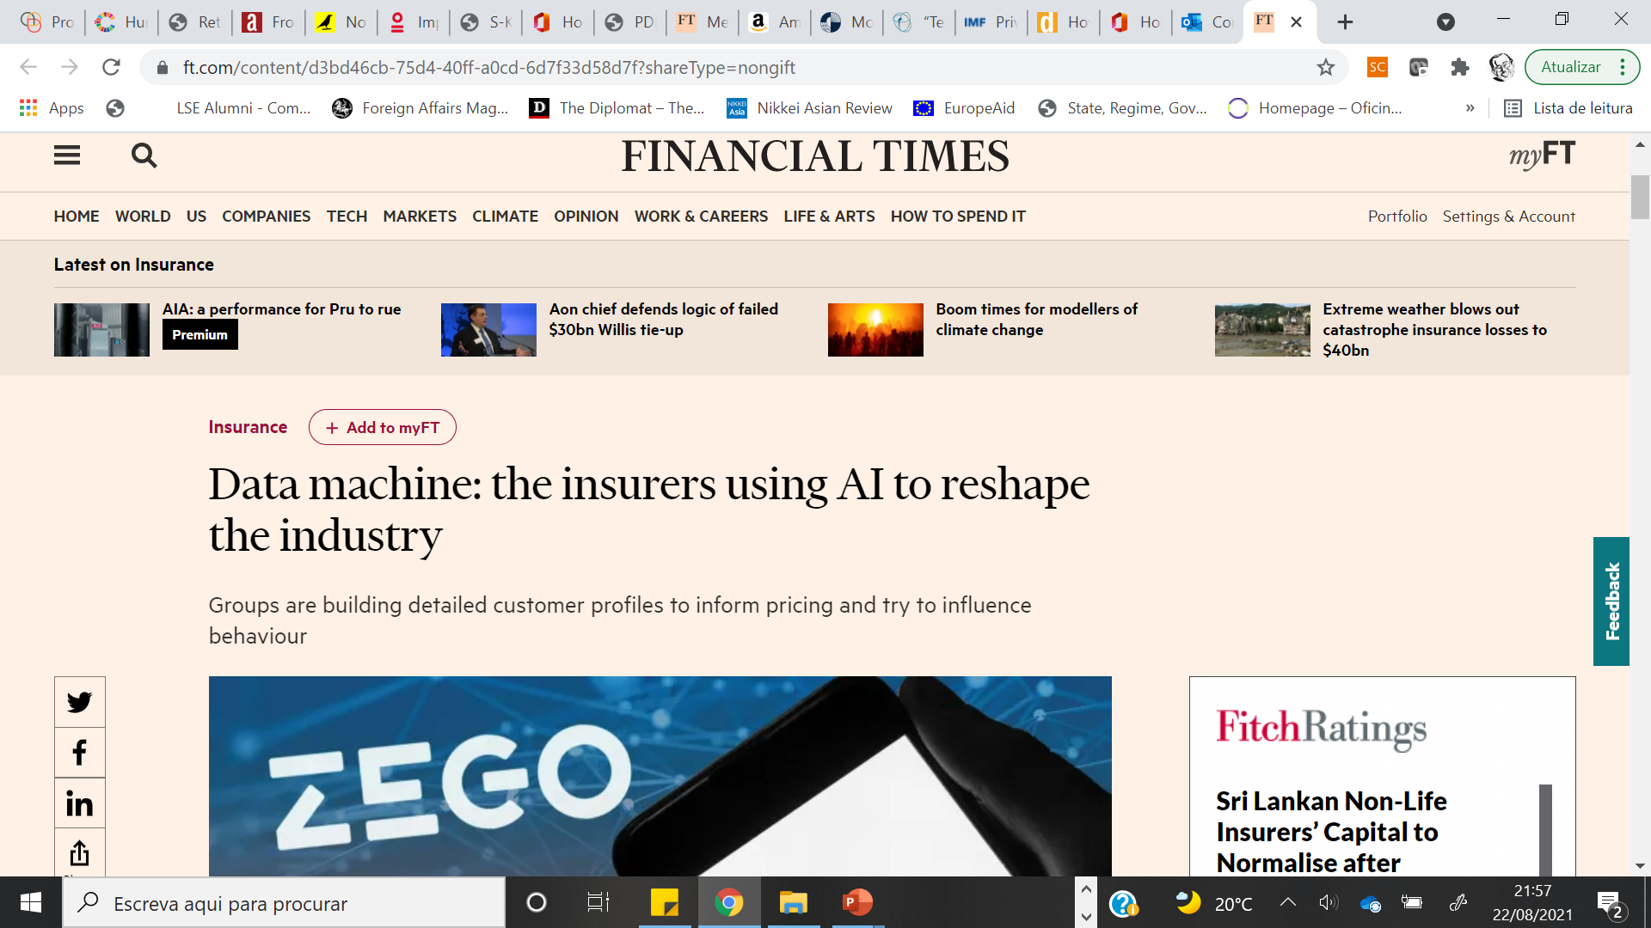

Slide 34
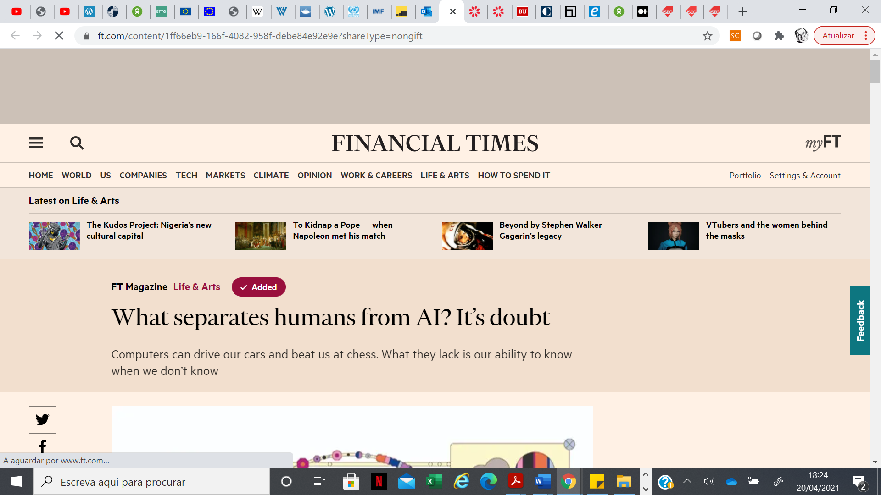

Slide 35
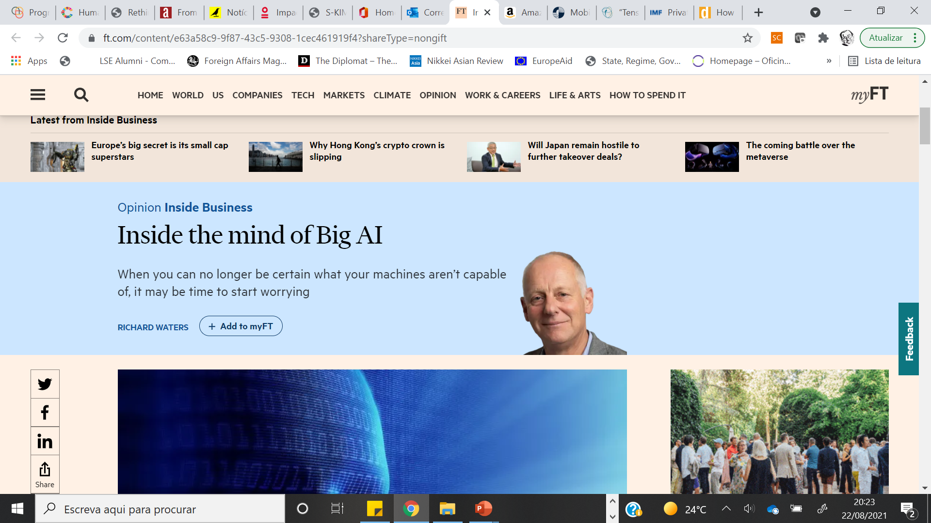


Slide 36
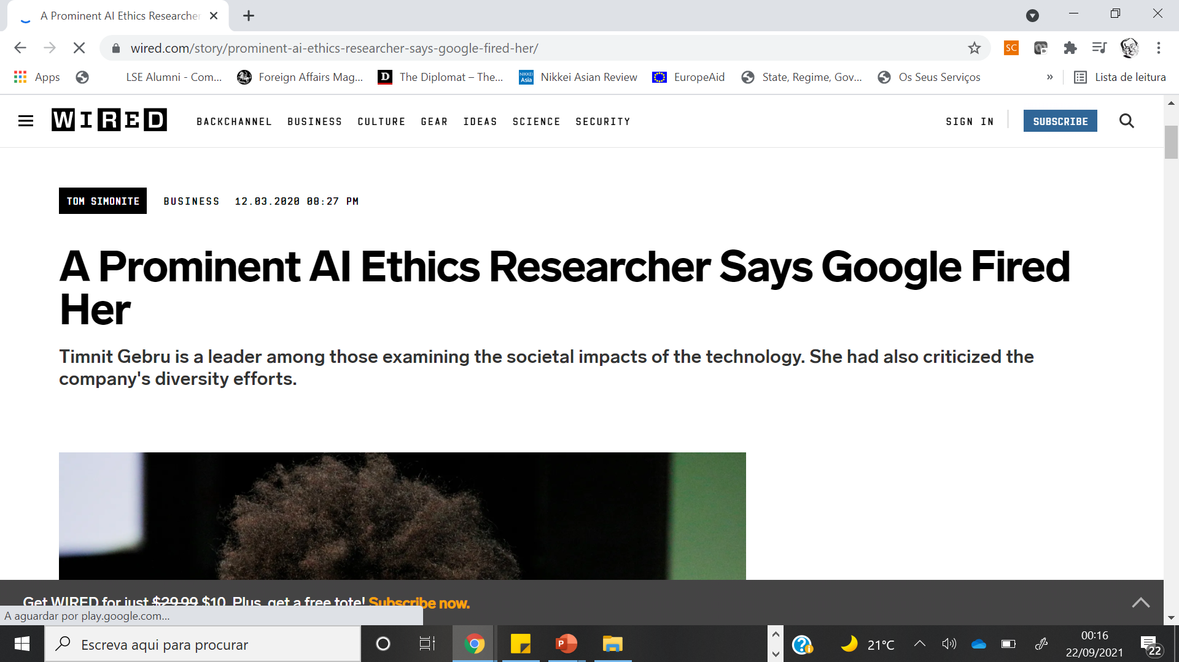

Slide 37
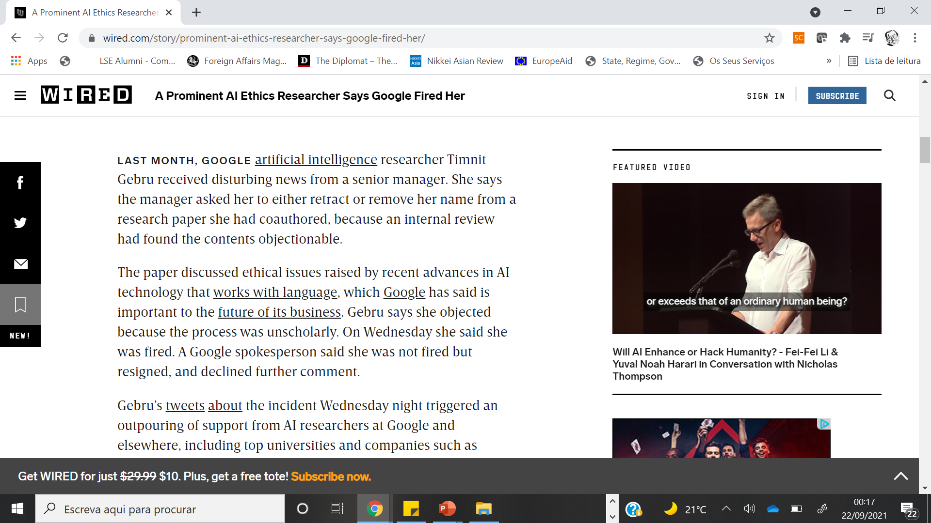

Slide 38
How do we hold algorithms accountable?

Slide 39
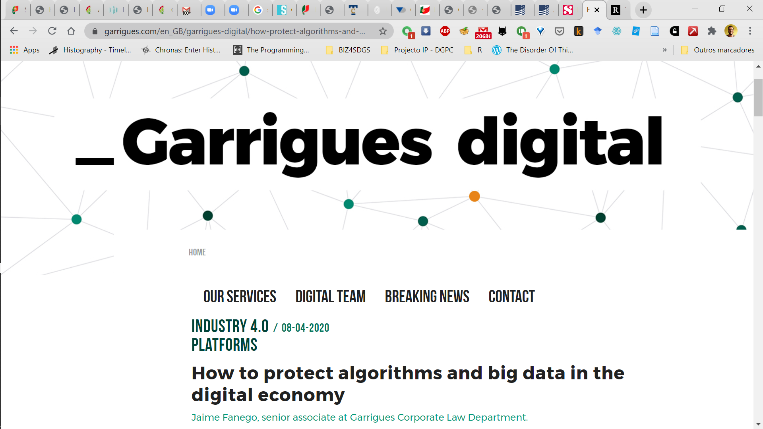
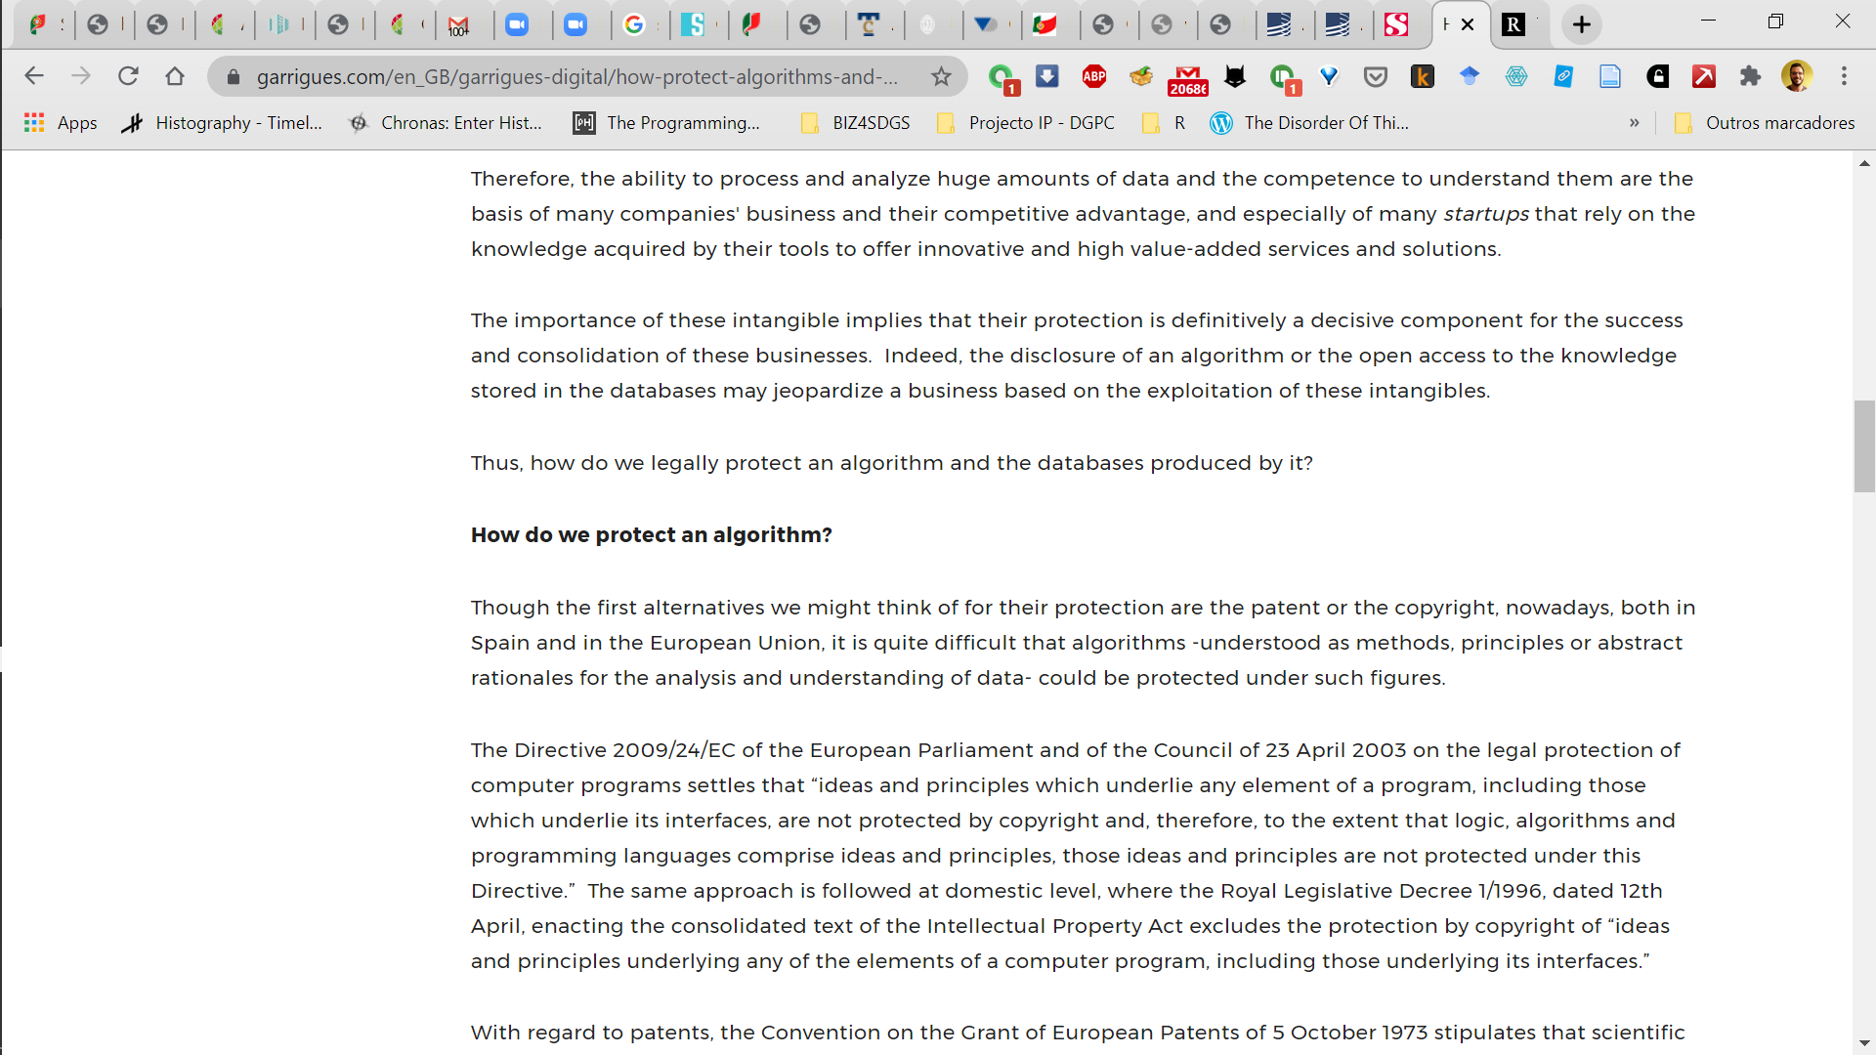
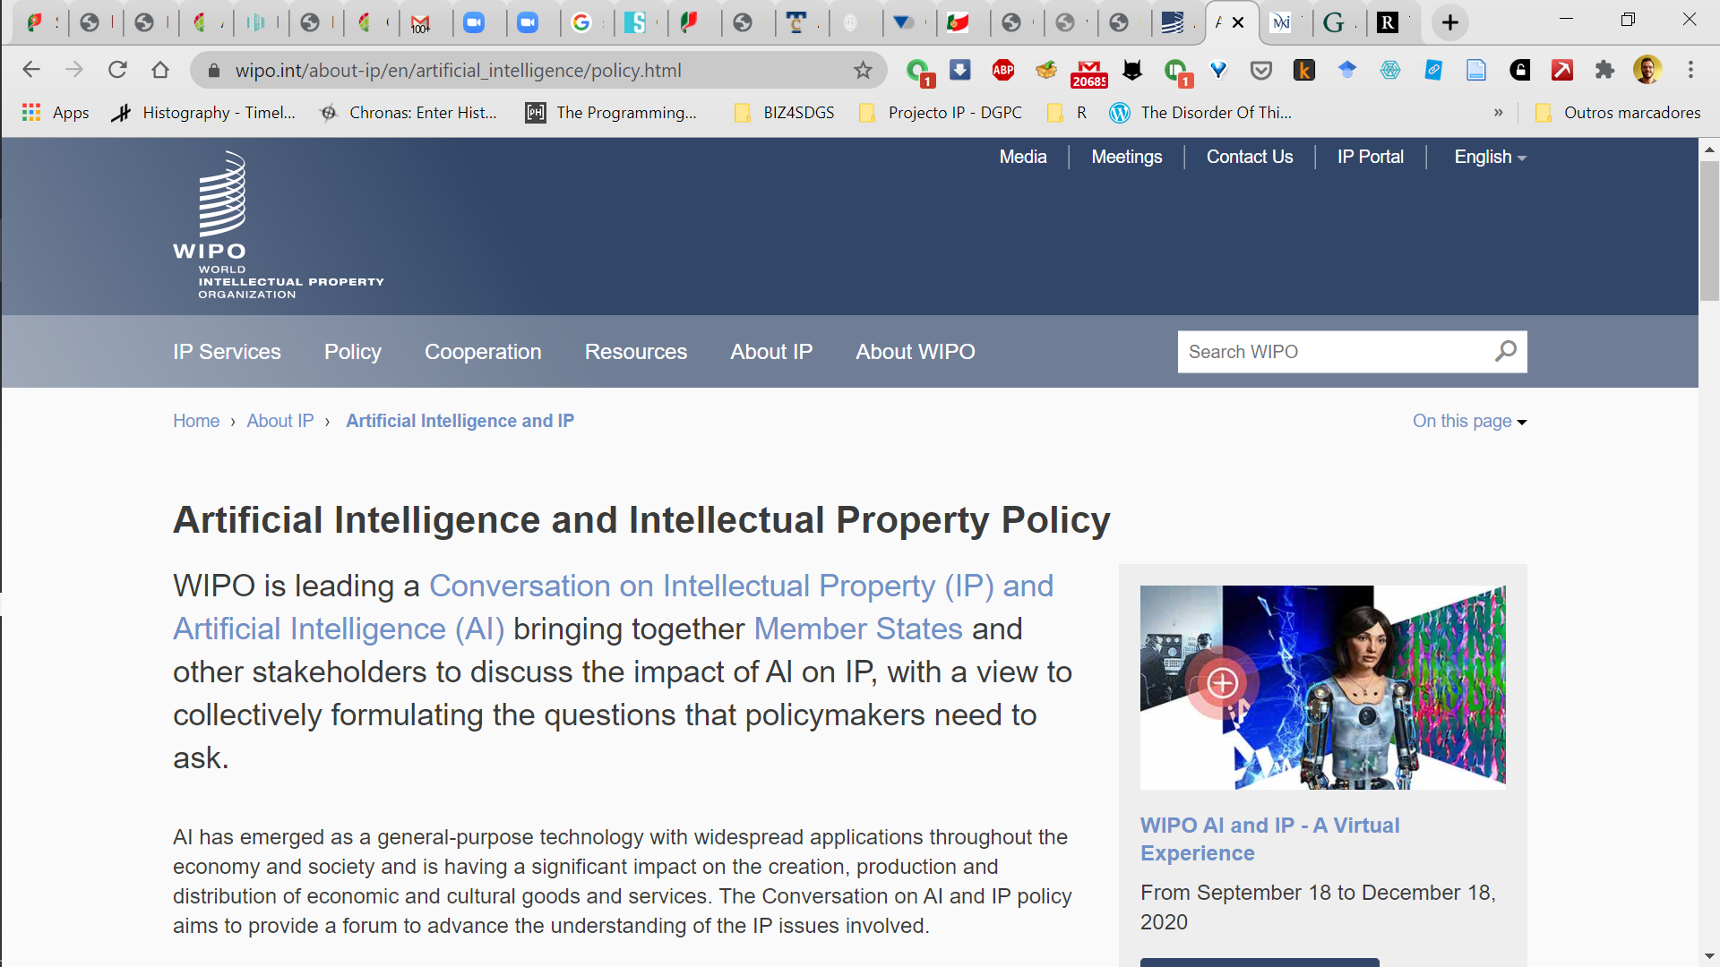

Slide 40
The Rise of Big Tech

Slide 41








BIG TECH!
A imagem Esta Fotografia de Autor Desconhecido está licenciada ao abrigo da CC BY-SA
A imagem Esta Fotografia de Autor Desconhecido está licenciada ao abrigo da CC BY-SA
A imagem Esta Fotografia de Autor Desconhecido está licenciada ao abrigo da CC BY-SA
A imagem Esta Fotografia de Autor Desconhecido está licenciada ao abrigo da CC BY-SA
A imagem Esta Fotografia de Autor Desconhecido está licenciada ao abrigo da CC BY-SA-NC
A imagem Esta Fotografia de Autor Desconhecido está licenciada ao abrigo da CC BY-SA-NC
A imagem Esta Fotografia de Autor Desconhecido está licenciada ao abrigo da CC BY-SA

Slide 42
The Rise…
 | 2006 |  | 2010 |  | 2015
Rank | Company | Sector | Company | Sector | Company | Sector
1 | Exxon Mobil | Oil and Gas | PetroChina | Oil and Gas | Apple | TECH
2 | General Electric | Industrial | Exxon Mobil | Oil and Gas | Exxon Mobil | Oil and Gas
3 | Microsoft | TECH | Microsoft | TECH | Berkshire Hathaway | Financials
4 | Citigroup | Financials | ICBC | Financials | Google | TECH
5 | BP | Oil and Gas | Apple | TECH | Microsoft | TECH
6 | Bank of America | Financials | BHP Billiton | Mining | PetroChina | Oil and Gas
7 | Royal Dutch Shell | Oil and Gas | Walmart | Retail | Wells Fargo | Financials
8 | Walmart | Retail | Berkshire Hathaway | Financials | Johnson & Johnson | Pharmaceuticals
9 | Toyota | Automotive | General Electric | Industrials | ICBC | Financials
10 | Gazprom | Oil and Gas | China Mobile | Telecom | Novartis | Pharmaceuticals
Source: Financial Times, various years

Slide 43
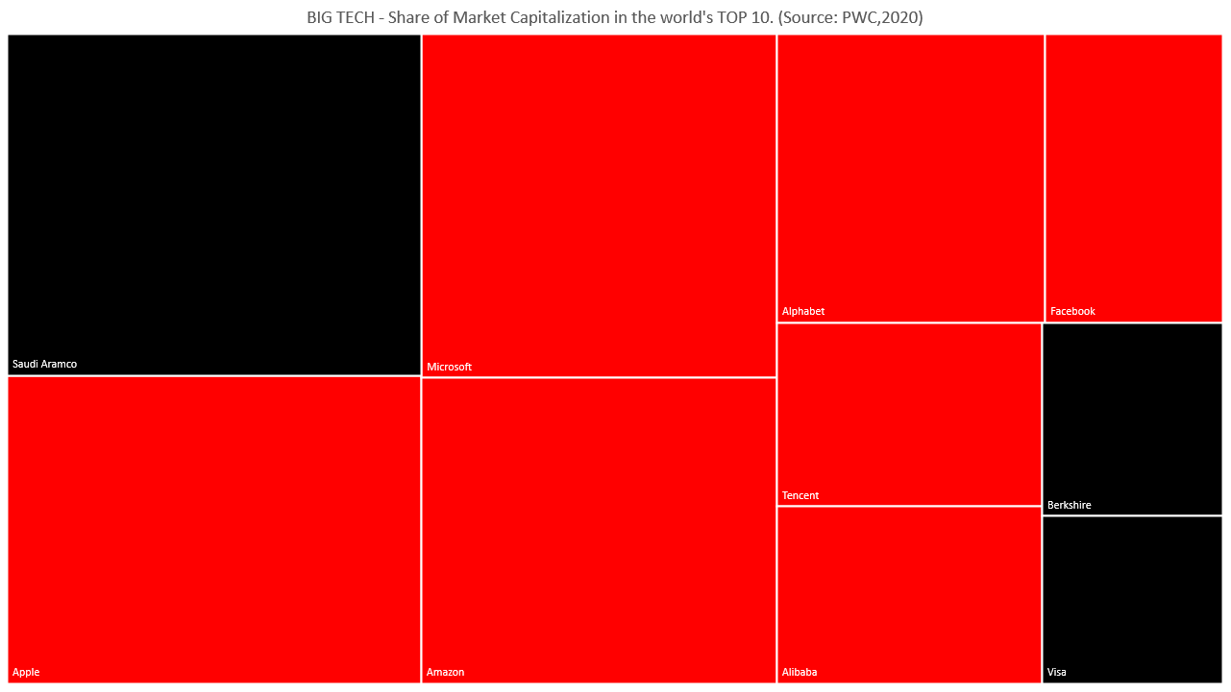

Slide 44
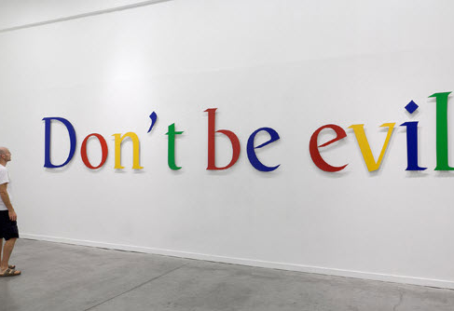
Some facts…
95% of internet-using adults under 30 are on Facebook or Instagram (acquired in 2012)
95% of searches by Google
Google + Facebook =around 90 % of world’s new ad spending
Google + Apple= 99% of phone operating systems
Apple + Microsoft = 95 % of desktop operating systems
Amazon= app. half of US e-commerce
Source:Foroohar (2019)
A imagem Esta Fotografia de Autor Desconhecido está licenciada ao abrigo da CC BY

Slide 45
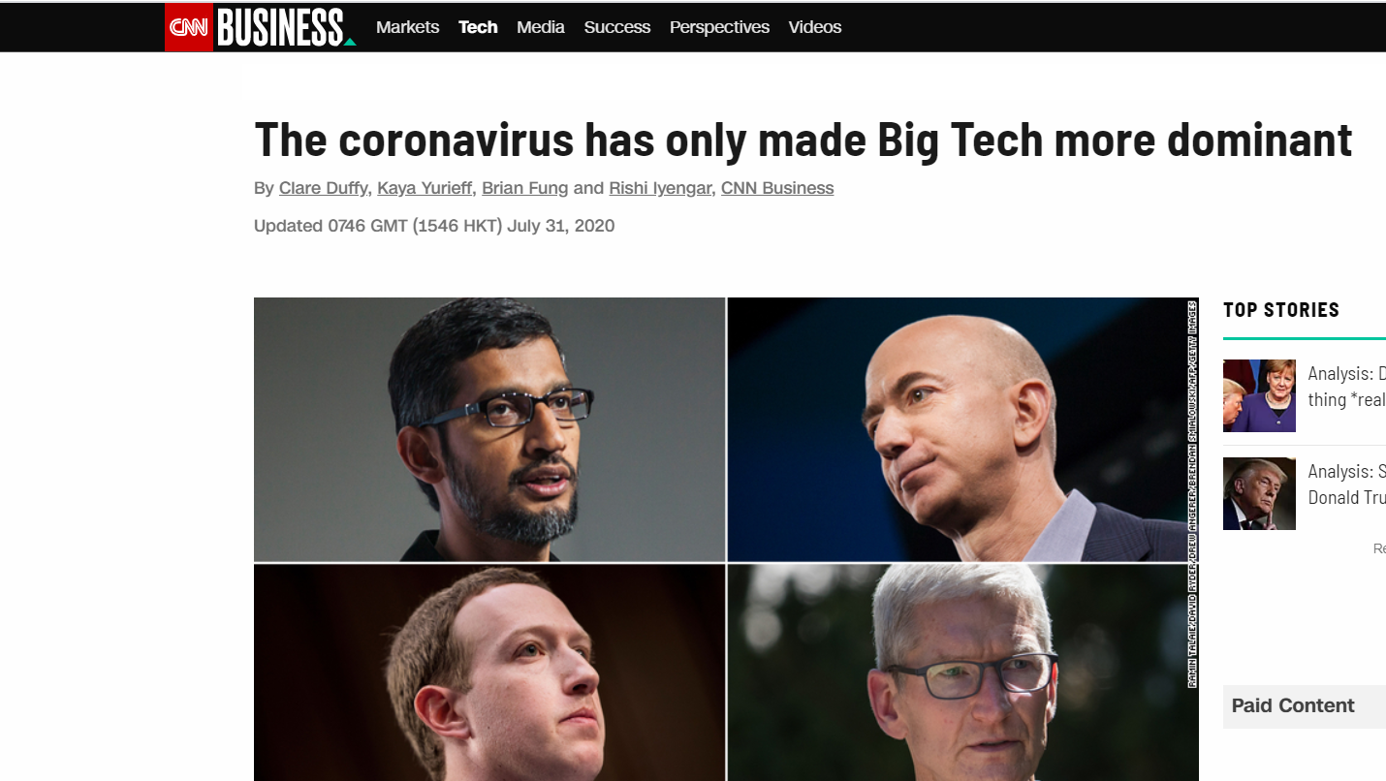

Slide 46
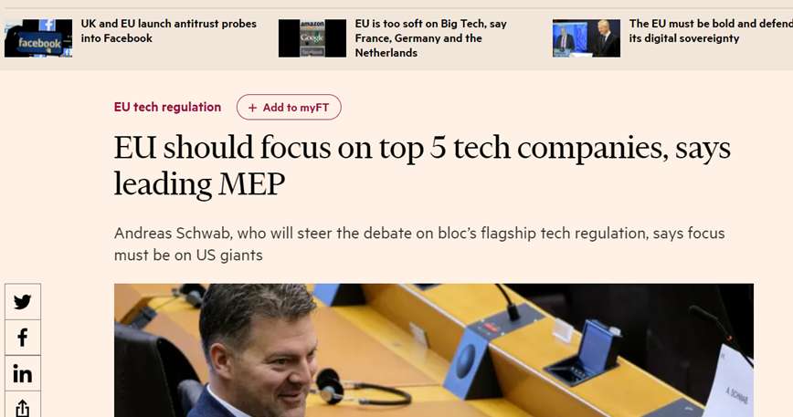

Slide 47
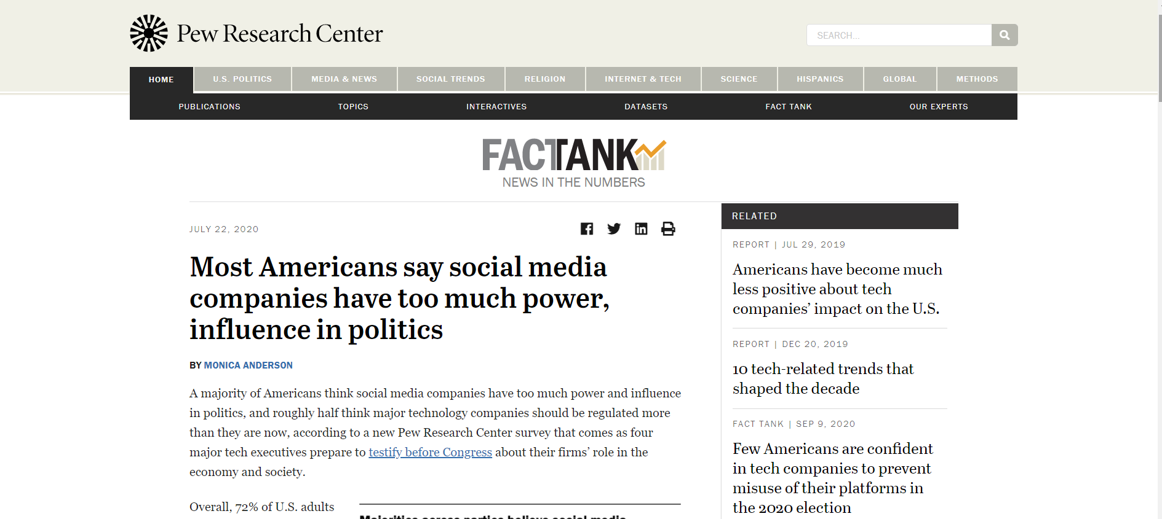
‘Influencers’

Slide 48
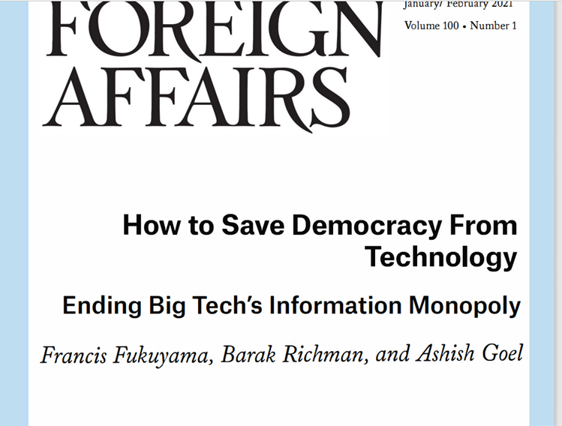

Slide 49
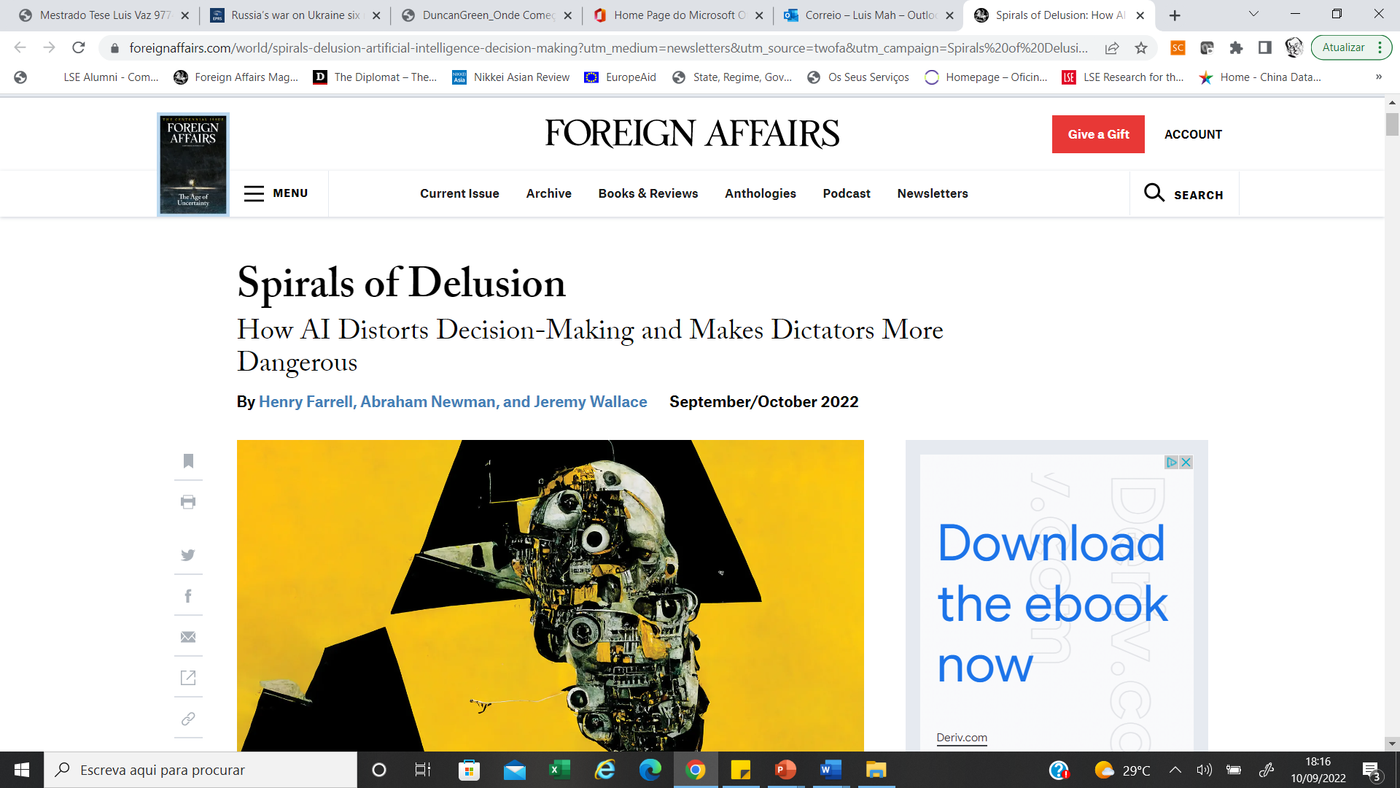

Slide 50
Some food for thought…

